Slide 1

O LEVEL PROJECT

Slide 2
PROJECT TITLE
PORTFOLIO WEBSITE
Using HTML,CSS and Javascript
Student’s Name: Manu Deshwal
Registration No.:1608635
Admission Mode: Institute
Institute’s Name: ACCR-01751-THE PROFESSIONALS(AUTHORISED BY TALLY INDIA PVT. LTD.),MEERUT

Slide 3
Project Completion Certificate
This is to certify that the project work done by Mr. Manu Deshwal(NIELIT Registration No.1608635) in partial fulfillment of DOEACC ‘O’ level(IT) Examination at THE PROFESSIONALS(AUTHORISED BY TALLY INDIA PVT. LTD.),MEERUT has been found satisfactory. This report has not been submitted for any other examination and does not form part of any other course undergone by the candidate.
Name: Neeta Chamoli
Organization Name: Accr-01751-The Professionals(Authorized By Tally India Pvt. Ltd.)
Address: Meerut,Uttar Pradesh

Slide 4
PORTFOLIO WEBSITE
Project Overview:
Welcome to my portfolio website,a showcase of my skills and projects.This site is designed to be a personal online space where you can learn about my work,skills and how to contact me.It’s built using HTML,CSS and Javascript to ensure a responsive and interactive experience.
Visit website from here:
https://github.com/manudeshwal6/manu_project.git

Slide 5
Technoligies Used:
1.HTML
- Provides the structure and layout of the website.
- Creates different pages like Home,About,Projects and Contact.
2.CSS
- Adds styling to make the site visually appealing.
- Ensures a responsive design for various screen sizes and devices.
3.Javascript
- Brings interactivity and dynamic content.
- Validates forms,loads content dynamically and adds interactive elements.
Website Features:
Home Page: Introduction and navigation to different sections.
About Page: My background,education and experience.

Slide 6
Projects Page: Showcases my projects with descriptions and links.
Contact Page: Contact form and social media links.
Blog Page: Articles and updates.
Resume Page: Detailed resume with a downlodable PDF.
Gallery Page: Interactive Image Gallery.
Skills Page: List of skills with visual representation.
FAQ Page: Answers to frequently asked questions.
Conclusion:
This portfolio website demonstrates the web development skills I’ve learned
Showcasing my ability to create a structured,visually appealing and interactive web presence.It serves as a testament to my skills and knowledge in web development.

Slide 7
HOME PAGE CODE AND IMAGE

Slide 8
<!DOCTYPE html>
<html lang="en">
<head>
<meta charset="UTF-8">
<meta name="viewport" content="width=device-width, initial-scale=1.0">
<link rel="stylesheet" href="CSS code.css">
<link rel="stylesheet" href="https://cdnjs.cloudflare.com/ajax/libs/font-awesome/6.0.0-beta3/css/all.min.css">
<script src="function.js"></script>
<title>Home - My Portfolio</title>
</head>
<body bgcolor="fdddaa">
<header>
<h1>My Portfolio</h1>
<nav>
<ul>
<li><a href="index.html">Home</a></li>
<li><a href="about.html">About</a></li>
<li><a href="projects.html">Projects</a></li>
<li><a href="contact.html">Contact</a></li>
<li><a href="blog.html">Blog</a></li>
<li><a href="resume.html">Resume</a></li>
<li><a href="gallery.html">Gallery</a></li>
<li><a href="skills.html">Skills</a></li>
<li><a href="faq.html">FAQ</a></li>
</ul>
</nav>
</header>
<section>
<h2>O LEVEL PROJECT</h2>
<p><b>Student's Name:</b>Manu Deshwal</p>
<p><b>Registration No.:</b>1608635</p>
<p><b>Institute's Name:</b>The Professionals(Authorised By Tally India Pvt. Ltd),Meerut</p>
<p><b>Submission Date:</b>12-August-2024</p>
</section>

Slide 9
<main>
<h2>Welcome to My Portfolio</h2>
<p>Explore my work,projects and skills</p>
<button onclick="showAlert()">Click Here!</button>
</main>
<footer>
<p>&copy; 2024 My Portfolio</p>
<div class="social-links">
<a href="https://www.facebook.com/yourprofile" target="_blank"><i class=
"fab fa-facebook"></i>Facebook</a>
<a href="https://www.instagram.com/yourprofile" target="_blank"><i class=
"fab fa-instagram"></i>Instagram</a>
<a href="mailto:youremail@example.com"><i class="fas fa-envelope"></li>
Email</a>
<a href="https://www.linkedin.com/in/yourprofile" target="_blank"><i class=
"fab fa-linkedin"></i>LinkedIn</a>
<a href="https://www.twitter.com/yourprofile" target="_blank"><i class=
"fab fa-twitter"></i>Twitter</a>
</div>
</footer>
</body>
</html>

Slide 10
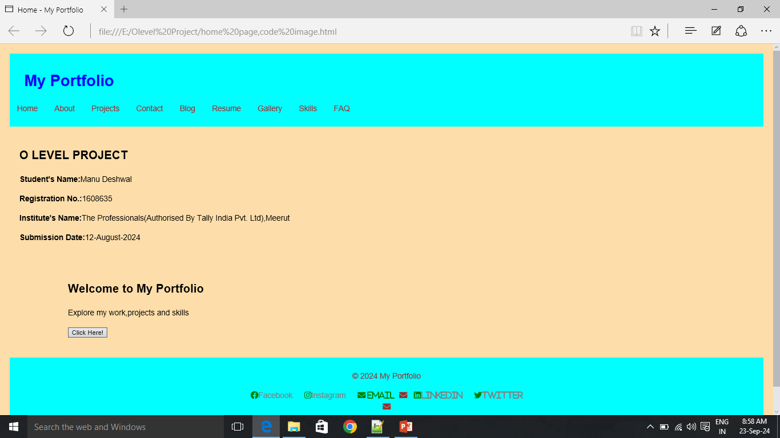

Slide 11
ABOUT PAGE CODE AND IMAGE

Slide 12
<!DOCTYPE html>
<html lang="en">
<head>
<meta charset="UTF-8">
<meta name="viewport" content="width=device-width, initial-scale=1.0">
<link rel="stylesheet" href="CSS code.css">
<link rel="stylesheet" href="https://cdnjs.cloudflare.com/ajax/libs/font-awesome/6.0.0-beta3/css/all.min.css">
<script src="function.js" defer></script>
<title>About - My Portfolio</title>
</head>
<body bgcolor="fdddaa">
<header>
<h1>About Me</h1>
<nav>
<ul>
<li><a href="index.html">Home</a></li>
<li><a href="about.html">About</a></li>
<li><a href="projects.html">Projects</a></li>
<li><a href="contact.html">Contact</a></li>
<li><a href="blog.html">Blog</a></li>
<li><a href="resume.html">Resume</a></li>
<li><a href="gallery.html">Gallery</a></li>
<li><a href="skills.html">Skills</a></li>
<li><a href="faq.html">FAQ</a></li>
</ul>
</nav>
</header>

Slide 13
<main>
<section>
<h2>About Me</h2>
<p>My Name is Manu Deshwal, and I am currently enrolled in the O Level course at The Proffesionals(Authorized By Tally India Pvt. Ltd.),Meerut.I spend three hours each day at the institute,where I am actively learning various O Level modules</p>
<p>My experience here has been enriching and engaging.The instructors are knowledgeable and provide valuable insights,making complex topics easier to understand.I appreciate the supportive learning environment and the emphasis on practical application</p>
<p>Being part of this institute has motivated me to excel in my studies,and I am excited to continue my acedemic journey while preparing for the O Level examination.</p>
<p>I have completed all the Four O Level modules here that include:</p>
<ul>
<li>Information Technology Tools and Network Basics (M1-R5)</li>
<li>Web Designing and Publishing (M2-R5)</li>
<li>Programming and Problem Solving Through Python(M3-R5)</li>
<li>Internet of Things and Its Applications(M4-R5)</li>
</ul>
</section>
</main>
<footer>
<p>&copy; 2024 My Portfolio</p>
<div class="social-links">
<a href="https://www.facebook.com/yourprofile" target="_blank"><i class=
"fab fa-facebook"></li>Facebook</a>
<a href="https://www.instagram.com/yourprofile" target="_blank"><i class=
"fab fa-instagram"></li>Instagram</a>
<a href="mailto:youremail@example.com" target="_blank"><i class=
"fab fa-envelope"></li>Email</a>
<a href="https://www.linkedin.com/in/yourprofile" target="_blank"><i class=
"fab fa-linkedin"></li>LinkedIn</a>
<a href="https://www.twitter.com/yourprofile" target="_blank"><i class=
"fab fa-twitter"></li>Twitter</a>
</div>
</footer>
</body>
</html>

Slide 14
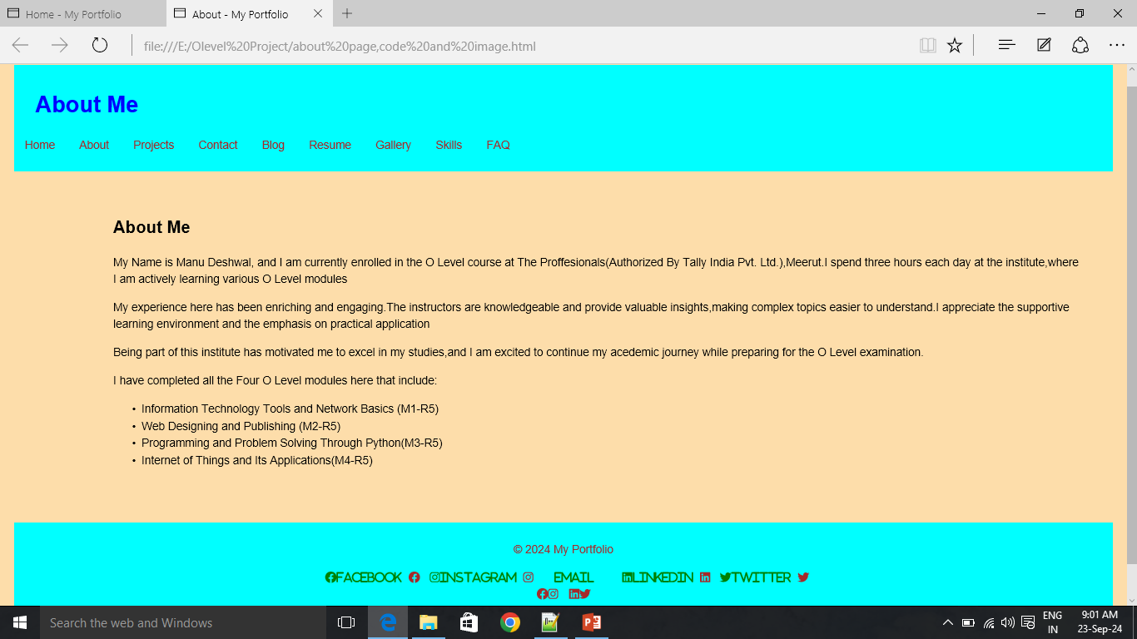

Slide 15
PROJECTS PAGE CODE AND IMAGE

Slide 16
<!DOCTYPE html>
<html lang="en">
<head>
<meta charset="UTF-8">
<meta name="viewport" content="width=device-width, initial-scale=1.0">
<link rel="stylesheet" href="CSS code.css">
<link rel="stylesheet" href="https://cdnjs.cloudflare.com/ajax/libs/font-awesome/6.0.0-beta3/css/all.min.css">
<script src="function.js" defer></script>
<script src="function.js" defer>
</script>
<title>Projects - My Portfolio</title>
</head>
<body bgcolor="fdddaa">
<header>
<h1>My Projects</h1>
<nav>
<ul>
<li><a href="index.html">Home</a></li>
<li><a href="about.html">About</a></li>
<li><a href="projects.html">Projects</a></li>
<li><a href="contact.html">Contact</a></li>
<li><a href="blog.html">Blog</a></li>
<li><a href="resume.html">Resume</a></li>
<li><a href="gallery.html">Gallery</a></li>
<li><a href="skills.html">Skills</a></li>
<li><a href="faq.html">FAQ</a></li>
</ul>
</nav>
</header>

Slide 17
<main>
<h2>Projects Overview</h2>
<p>Here are some of the projects I have worked on:</p>
<ul>
<li><b>Web Designing and Publishing Projects:</b></li>
<br>
<ul>
<li><a href="project1.html" download>Admission Form</a></li>
<li><a href="project2.html" download>All in One Calculator</a></li>
<li><a href="project3.html" download>Simple Interest</a></li>
<li><a href="project4.html" download>Compound Interest</a></li>
<li><a href="project5.html" download>Remove pic when on clicked</a></li>
<br>
<li><b>Programming and Problem solving through Python projects:</b>
<br>
<ul>
<li><a href="project6.pdf">All Python Codes</a></li>
</ul>
<br>
<ul>
<li><a href="project7.png" download>LED Pattern Blinking</a></li>
<li><a href="project8.png" download>LCD</a></li>
<li><a href="project9.png" download>Gas Sensor</a></li>
<li><a href="project10.png" download>Servo Motor</a></li>
<li><a href="project11.png" download>Motion Detection</a></li>
</ul>
</ul>
</main>

Slide 18
<footer>
<p>&copy; 2024 My Portfolio</p>
<div class="social-links">
<a href="https://www.facebook.com/yourprofile" target="_blank"><i class=
"fab fa-facebook"></li>Facebook</a>
<a href="https://www.instagram.com/yourprofile" target="_blank"><i class=
"fab fa-instagram"></li>Instagram</a>
<a href="mailto:youremail@example.com" target="_blank"><i class=
"fab fa-envelope"></li>Email</a>
<a href="https://www.linkedin.com/in/yourprofile" target="_blank"><i class=
"fab fa-linkedin"></li>LinkedIn</a>
<a href="https://www.twitter.com/yourprofile" target="_blank"><i class=
"fab fa-twitter"></li>Twitter</a>
</div>
</footer>
</body>
</html>

Slide 19
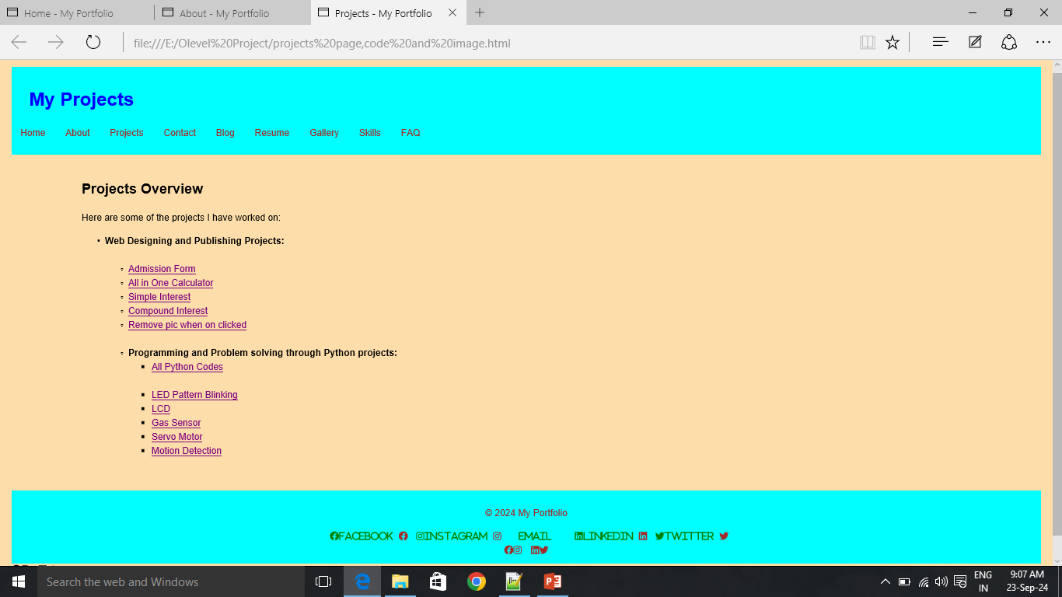

Slide 20
CONTACT PAGE CODE AND IMAGE

Slide 21
<!DOCTYPE html>
<html lang="en">
<head>
<meta charset="UTF-8">
<meta name="viewport" content="width=device-width, initial-scale=1.0">
<link rel="stylesheet" href="CSS code.css">
<link rel="stylesheet" href="https://cdnjs.cloudflare.com/ajax/libs/font-awesome/6.0.0-beta3/css/all.min.css">
<script src="function.js" defer></script>
<title>Contact - My Portfolio</title>
</head>
<body bgcolor="fdddaa">
<header>
<h1>Contact Me</h1>
<nav>
<ul>
<li><a href="index.html">Home</a></li>
<li><a href="about.html">About</a></li>
<li><a href="projects.html">Projects</a></li>
<li><a href="contact.html">Contact</a></li>
<li><a href="blog.html">Blog</a></li>
<li><a href="resume.html">Resume</a></li>
<li><a href="gallery.html">Gallery</a></li>
<li><a href="skills.html">Skills</a></li>
<li><a href="faq.html">FAQ</a></li>
</ul>
</nav>
</header>

Slide 22
<main>
<h2>Contact Information</h2>
<p>If you would like to get in touch,please fill out the form below:</p>
<form>
<input type="text" placeholder="Your Name:-" required>
<input type="email" placeholder="Your email:-" required>
<textarea placeholder="Your Message:-" required></textarea>
<button type="submit">Send</button>
</form>
</main>
<footer>
<p>&copy; 2024 My Portfolio</p>
<div class="social-links">
<a href="https://www.facebook.com/yourprofile" target="_blank"><i class=
"fab fa-facebook"></li>Facebook</a>
<a href="https://www.instagram.com/yourprofile" target="_blank"><i class=
"fab fa-instagram"></li>Instagram</a>
<a href="mailto:youremail@example.com" target="_blank"><i class=
"fab fa-envelope"></li>Email</a>
<a href="https://www.linkedin.com/in/yourprofile" target="_blank"><i class=
"fab fa-linkedin"></li>LinkedIn</a>
<a href="https://www.twitter.com/yourprofile" target="_blank"><i class=
"fab fa-twitter"></li>Twitter</a>
</div>
</footer>
</body>
</html>

Slide 23
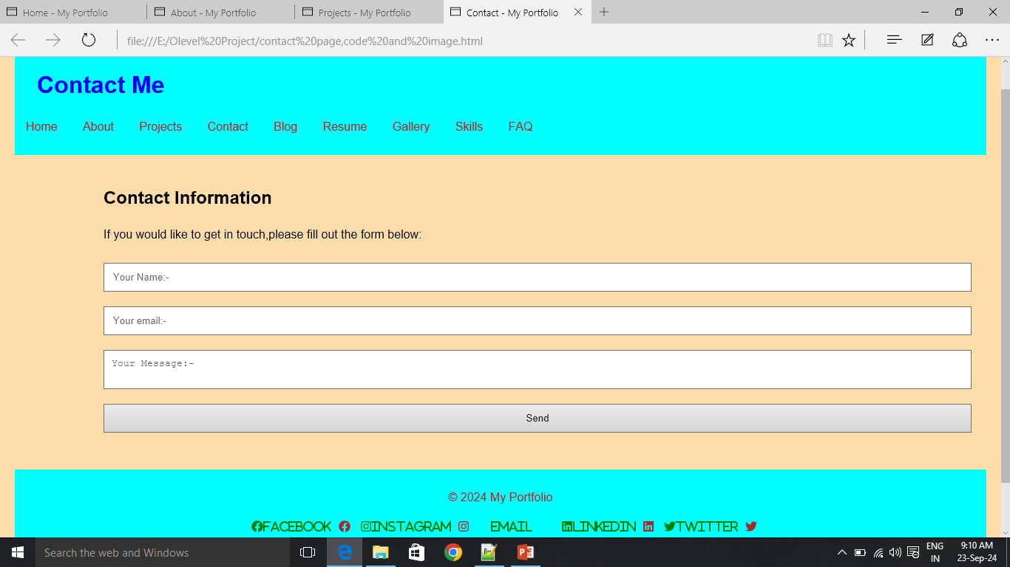

Slide 24
BLOG PAGE CODE AND IMAGE

Slide 25
<!DOCTYPE html>
<head>
<style>
.gallery
{
width:90%;
padding:20px;
margin:100px auto;
display:flex;
flex-direction:row;
justify-content:center;
}
.box
{
width:250px;
margin:0 10px;
transition:1s;
}
.box img
{
display:block;
width:100%;
border-radius:10px 0px 10px 0;
}
.box:hover
{
transform:scale(1.3);
z-index:2;
}
</style>
<script src="function.js" defer>
</script>
<title>Blog - My Portfolio</title>
<link rel="stylesheet" href="CSS code.css">
</head>

Slide 26
<body bgcolor="fdddaa">
<header>
<h1>My Blog</h1>
<nav>
<ul>
<li><a href="index.html">Home</a></li>
<li><a href="about.html">About</a></li>
<li><a href="projects.html">Projects</a></li>
<li><a href="contact.html">Contact</a></li>
<li><a href="blog.html">Blog</a></li>
<li><a href="resume.html">Resume</a></li>
<li><a href="gallery.html">Gallery</a></li>
<li><a href="skills.html">Skills</a></li>
<li><a href="faq.html">FAQ</a></li>
</ul>
</nav>
</header>
<main>
<h1 align="center">Useful Study Material for O Level</h1>
<div class="gallery">
<div class="box">
<a href="https://www.theprofessionals.com/">
<img src="pic1.jpg">
</a>
<div class="image-text" align="center">
<b>The Professionals</b></div>
</div>
<div class="box">
<a href="https://www.tinkercad.com/">
<img src="tinker cad.png">
</a>
<div class="image-text" align="center">
<b>Tinker Cad</b></div>
</div>

Slide 27
<div class="box">
<a href="https://www.w3schools.com/">
<img src="pic3.jpg">
</a>
<div class="image-text" align="center">
<b>W3 Schools</b></div>
</div>
<div class="box">
<a href="https://www.nielit.com/">
<img src="nielit.png" height="90%">
</a>
<div class="image-text" align="center">
<b>Nielit</b></div>
</div>
<div class="box">
<a href="https://www.youtube.com/@NewIdeasyt">
<img src="pic5.jpg">
</a>
<div class="image-text" align="center">
<b>New Ideas Yt</b></div>
</div>
<div class="box">
<a href="https://www.libreoffice.com/">
<img src="libre office.png" height="90%">
</a>
<div class="image-text" align="center">
<b>Libre Office</b>
</div>
</div>
</main>

Slide 28
<footer>
<p>&copy; 2024 My Portfolio</p>
<div class="social-links">
<a href="https://www.facebook.com/yourprofile" target="_blank"><i class=
"fab fa-facebook"></li>Facebook</a>
<a href="https://www.instagram.com/yourprofile" target="_blank"><i class=
"fab fa-instagram"></li>Instagram</a>
<a href="mailto:youremail@example.com" target="_blank"><i class=
"fab fa-envelope"></li>Email</a>
<a href="https://www.linkedin.com/in/yourprofile" target="_blank"><i class=
"fab fa-linkedin"></li>LinkedIn</a>
<a href="https://www.twitter.com/yourprofile" target="_blank"><i class=
"fab fa-twitter"></li>Twitter</a>
</div>
</footer>
</body>
</html>

Slide 29
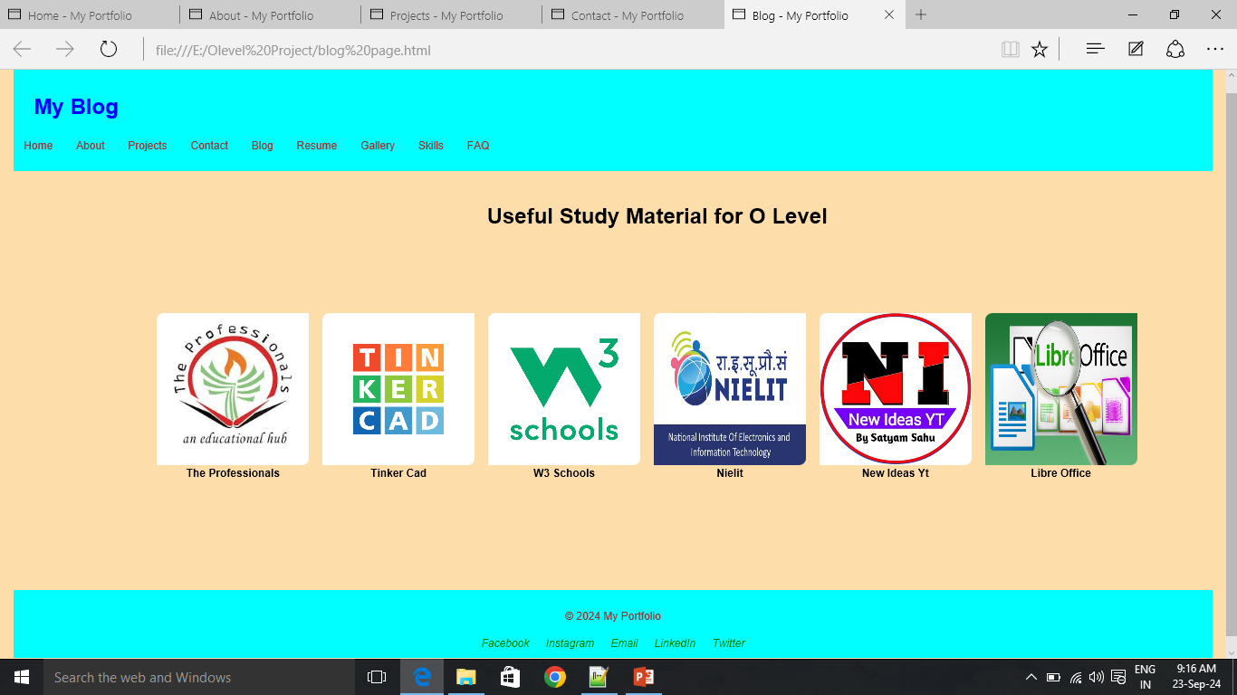

Slide 30
RESUME PAGE CODE AND IMAGE

Slide 31
<!DOCTYPE html>
<html lang="en">
<head>
<meta charset="UTF-8">
<meta name="viewport" content="width=device-width,initial-scale=1.0">
<link rel="stylesheet" href="CSS code.css">
<link rel="stylesheet" href=
"https://cdnjs.cloudflare.com/ajax/libs/font-awesome/6.0.0-beta3/css/all.min.css">
<script src="function.js" defer></script>
<title>Resume - My Portfolio</title>
</head>
<body bgcolor="fdddaa">
<header>
<h1>My Resume</h1>
<nav>
<ul>
<li><a href="index.html">Home</a></li>
<li><a href="about.html">About</a></li>
<li><a href="projects.html">Projects</a></li>
<li><a href="contact.html">Contact</a></li>
<li><a href="blog.html">Blog</a></li>
<li><a href="resume.html">Resume</a></li>
<li><a href="gallery.html">Gallery</a></li>
<li><a href="skills.html">Skills</a></li>
<li><a href="faq.html">FAQ</a></li>
</ul>
</nav>
</header>

Slide 32
<main>
<h2>Download My Resume</h2>
<a href="Manu_Resume.pdf" download>Download PDF</a>
<p>Here is a brief summary of my qualifications and experience.</p>
</main>
<footer>
<p>&copy; 2024 My Portfolio</p>
<div class="social-links">
<a href="https://www.facebook.com/yourprofile" target="_blank"><i class=
"fab fa-facebook"></li>Facebook</a>
<a href="https://www.instagram.com/yourprofile" target="_blank"><i class=
"fab fa-instagram"></li>Instagram</a>
<a href="mailto:youremail@example.com" target="_blank"><i class=
"fab fa-envelope"></li>Email</a>
<a href="https://www.linkedin.com/in/yourprofile" target="_blank"><i class=
"fab fa-linkedin"></li>LinkedIn</a>
<a href="https://www.twitter.com/yourprofile" target="_blank"><i class=
"fab fa-twitter"></li>Twitter</a>
</div>
</footer>
</body>
</html>

Slide 33
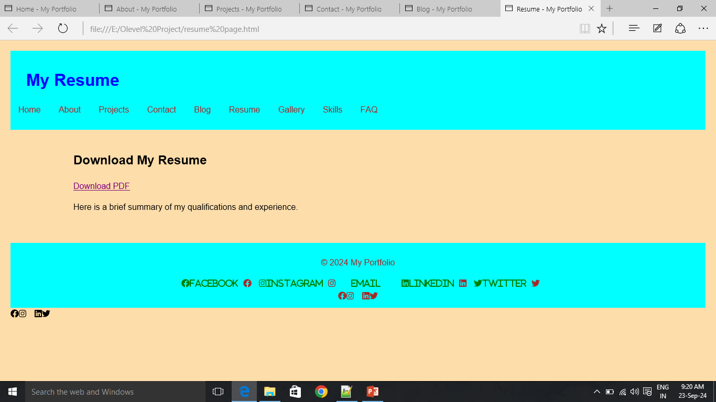

Slide 34
GALLERY PAGE CODE AND IMAGE

Slide 35
<!DOCTYPE html>
<html lang="en">
<head>
<meta charset="UTF-8">
<meta name="viewport" content="width=device-width, initial-scale=1.0">
<link rel="stylesheet" href="CSS code.css">
<style>
.gallery
{
width:90%;
padding:20px;
margin:100px auto;
display:flex;
flex-direction:row;
justify-content:center;
}
.box
{
width:250px;
margin:0 10px;
transition:1s;
}
.box img
{
display:block;
width:100%;
border-radius:10px 0px 10px 0;
}
.box:hover
{
transform:scale(1.3);
z-index:2;
}
</style>
<script src="function.js" defer>
</script>
<title>Gallery - My Portfolio</title>
</head>

Slide 36
<body bgcolor="fdddaa">
<header>
<h1>Gallery</h1>
<nav>
<ul>
<li><a href="index.html">Home</a></li>
<li><a href="about.html">About</a></li>
<li><a href="projects.html">Projects</a></li>
<li><a href="contact.html">Contact</a></li>
<li><a href="blog.html">Blog</a></li>
<li><a href="resume.html">Resume</a></li>
<li><a href="gallery.html">Gallery</a></li>
<li><a href="skills.html">Skills</a></li>
<li><a href="faq.html">FAQ</a></li>
</ul>
</nav>
</header>
<main>
<h2 align="center">Image Gallery</h2>
<p align="center">Photos of my work and projects:</p>
<div class="gallery">
<div class="box">
<img src="gallery img1.jpg" height="80%">
<div class="image-text" align="center">
Coaching Events</div>
</div>
<div class="box">
<img src="gallery img6.jpg" height="80%">
<div class="image-text" align="center">
My Computer</div>
</div>

Slide 37
<div class="box">
<img src="gallery img3.jpg" height="80%">
<div class="image-text" align="center">
Festival Celebration</div>
</div>
<div class="box">
<img src="gallery img2.jpg" height="80%">
<div class="image-text" align="center">
Classroom Party</div>
</div>
<div class="box">
<img src="my lab.jpg" height="80%">
<div class="image-text" align="center">
My Workspace in Lab</div>
</div>
<div class="box">
<img src="tally ghar.jpg" height="80%">
<div class="image-text" align="center">
Coaching Events</div>
</div>
</div>
</main>
<footer>
<p>&copy; 2024 My Portfolio</p>
<div class="social-links">
<a href="https://www.facebook.com/yourprofile" target="_blank"><i class=
"fab fa-facebook"></li>Facebook</a>
<a href="https://www.instagram.com/yourprofile" target="_blank"><i class=
"fab fa-instagram"></li>Instagram</a>
<a href="mailto:youremail@example.com" target="_blank"><i class=
"fab fa-envelope"></li>Email</a>
<a href="https://www.linkedin.com/in/yourprofile" target="_blank"><i class=
"fab fa-linkedin"></li>LinkedIn</a>
<a href="https://www.twitter.com/yourprofile" target="_blank"><i class=
"fab fa-twitter"></li>Twitter</a>
</div>
</footer>
</body>
</html>

Slide 38
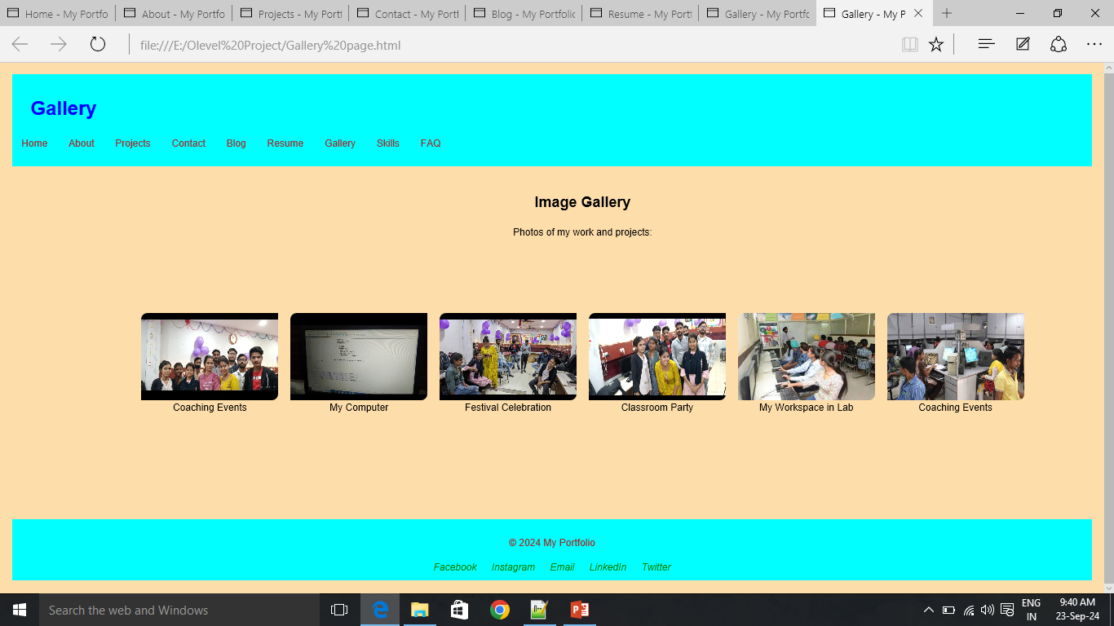

Slide 39
SKILLS PAGE CODE AND IMAGE

Slide 40
<!DOCTYPE html>
<html lang="en">
<head>
<meta charset="UTF-8">
<meta name="viewport" content="width=device-width, initial-scale=1.0">
<link rel="stylesheet" href="CSS code.css">
<link rel="stylesheet" href="https://cdnjs.cloudflare.com/ajax/libs/font-awesome/6.0.0-beta3/css/all.min.css">
<script src="function.js" defer>
</script>
<title>Skills - My Portfolio</title>
</head>
<body bgcolor="fdddaa">
<header>
<h1>My Resume</h1>
<nav>
<ul>
<li><a href="index.html">Home</a></li>
<li><a href="about.html">About</a></li>
<li><a href="projects.html">Projects</a></li>
<li><a href="contact.html">Contact</a></li>
<li><a href="blog.html">Blog</a></li>
<li><a href="resume.html">Resume</a></li>
<li><a href="gallery.html">Gallery</a></li>
<li><a href="skills.html">Skills</a></li>
<li><a href="faq.html">FAQ</a></li>
</ul>
</nav>
</header>

Slide 41
<h2>Skills Overview</h2>
<p>Here are some of my skills and expertise I have gained in O Level Course:</p>
<ul>
<li>MS-Office</li>
<li>Libre Office</li>
<li>Email and Social Media Handling</li>
<li>HTML Language</li>
<li>CSS Language</li>
<li>Javascript Language</li>
<li>Angular JS</li>
<li>Python Language</li>
<li>Numpy</li>
<li>C++ Language</li>
<li>Arduino Uno and Sensors</li>
<li>Soft Skills</li>
</ul>
<footer>
<p>&copy; 2024 My Portfolio</p>
<div class="social-links">
<a href="https://www.facebook.com/yourprofile" target="_blank"><i class=
"fab fa-facebook"></li>Facebook</a>
<a href="https://www.instagram.com/yourprofile" target="_blank"><i class=
"fab fa-instagram"></li>Instagram</a>
<a href="mailto:youremail@example.com" target="_blank"><i class=
"fab fa-envelope"></li>Email</a>
<a href="https://www.linkedin.com/in/yourprofile" target="_blank"><i class=
"fab fa-linkedin"></li>LinkedIn</a>
<a href="https://www.twitter.com/yourprofile" target="_blank"><i class=
"fab fa-twitter"></li>Twitter</a>
</div>
</footer>
</body>
</html>

Slide 42
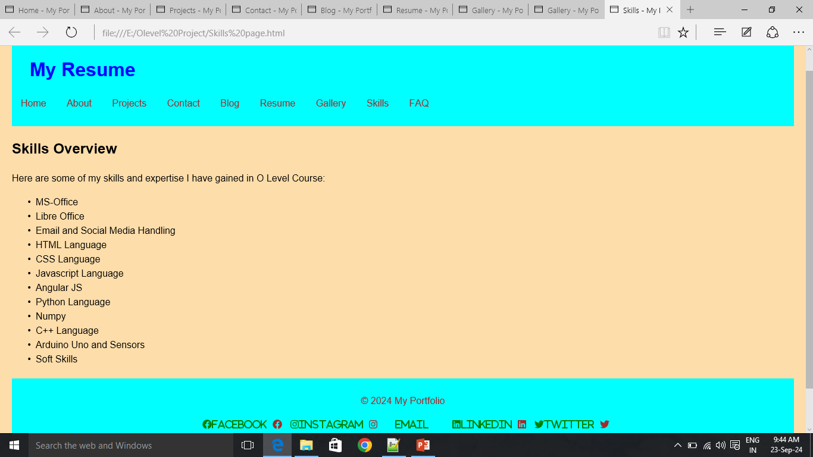

Slide 43
FAQ PAGE CODE AND IMAGE

Slide 44
<!DOCTYPE html>
<html lang="en">
<head>
<meta charset="UTF-8">
<meta name="viewport" content="width=device-width, initial-scale=1.0">
<link rel="stylesheet" href="CSS code.css">
<link rel="stylesheet" href="https://cdnjs.cloudflare.com/ajax/libs/font-awesome/6.0.0-beta3/css/all.min.css">
<script src="function.js" defer>
</script>
<title>FAQ - My Portfolio</title>
</head>
<body bgcolor="fdddaa">
<header>
<h1>My Resume</h1>
<nav>
<ul>
<li><a href="index.html">Home</a></li>
<li><a href="about.html">About</a></li>
<li><a href="projects.html">Projects</a></li>
<li><a href="contact.html">Contact</a></li>
<li><a href="blog.html">Blog</a></li>
<li><a href="resume.html">Resume</a></li>
<li><a href="gallery.html">Gallery</a></li>
<li><a href="skills.html">Skills</a></li>
<li><a href="faq.html">FAQ</a></li>
</ul>
</nav>
</header>

Slide 45
<h2>FAQ</h2>
<p>Common Questions and answers:</p>
<ul>
<li><b>Q:</b>
What technologies have you used to make this project?</li>
<li><b>A:</b>
I have used HTML,CSS,Javascript and MS Office to make this project</li>
<li><b>Q:</b>
How much time did it take you to complete this project?</li>
<li><b>A:</b>
It took nearly 10 Days to complete this project.</li>
<br>
<li><b>Q:</b>How can I contact you?</li>
<li><b>A:</b>You can reach me through the contact page.</li>
</ul>
<footer>
<p>&copy; 2024 My Portfolio</p>
<div class="social-links">
<a href="https://www.facebook.com/yourprofile" target="_blank"><i class=
"fab fa-facebook"></li>Facebook</a>
<a href="https://www.instagram.com/yourprofile" target="_blank"><i class=
"fab fa-instagram"></li>Instagram</a>
<a href="mailto:youremail@example.com" target="_blank"><i class=
"fab fa-envelope"></li>Email</a>
<a href="https://www.linkedin.com/in/yourprofile" target="_blank"><i class=
"fab fa-linkedin"></li>LinkedIn</a>
<a href="https://www.twitter.com/yourprofile" target="_blank"><i class=
"fab fa-twitter"></li>Twitter</a>
</div>
</footer>
</body>
</html>

Slide 46
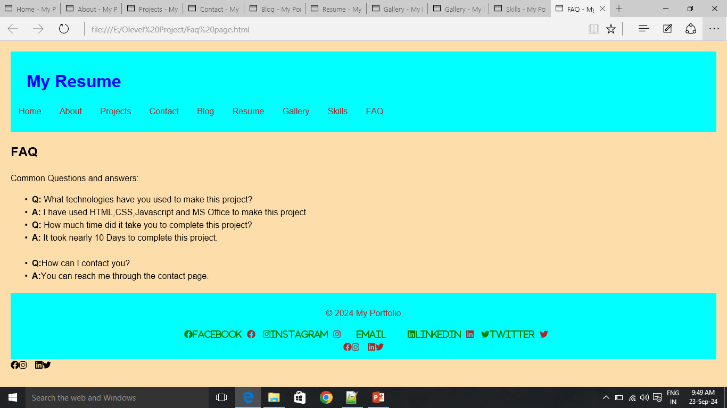

Slide 47
CSS & JAVASCRIPT FILE CODE

Slide 48
body
{
font-family:Arial,sans-serif;
line-height:1.5;
margin:0;
padding:0;
}
header
{
background:cyan;
color:blue;
padding:10px 0;
}
section
{
padding:20px;
}
nav ul
{
list-style:none;
padding:0;
}
nav ul li
{
display:inline;
margin:0 15px;
}
nav ul li a
{
color:brown;
text-decoration:none;
}
main
{
padding:20px;
margin-left:100px;
}

Slide 49
h1
{
margin-left:20px;
padding-left:10px;
}
footer
{
text-align:center;
margin-top:20px;
background:cyan;
color:brown;
padding:10px 0;
}
form
{
display:flex;
flex-direction:column;
}
form input,form textarea,form Button
{
margin:10px 0;
padding:10px;
}
.social-links
{
margin-top:10px;
}
.social-links a
{
margin:0 10px;
text-decoration:none;
color:grey;
}
.social-links a i
{
color:green;
}

Slide 50
.social-links a:hover
{
text-decoration:underline;
color:blue;
}
* 3 columns */
.social-links a:hover i
{
color:red;
}
body
{
font-family:Arial,sans-serif;
background-color:0f0f0;
padding:20px;
}
.image-grid
{
display:grid;
grid-template-columns:repeat(3,1fr);
gap:20px;
width:100%;
}
.image
{
display:flex;
flex-direction:column;
align-items:center;
background-color:ffffff;
padding:20px;
border-radius:10px;
box-shadow:0 4px 8px gba(0,0,0,0.1);
}
.image img
{
width:200px;
height:auto;
margin-bottom:10px;
}

Slide 51
.image-text
{
text-align:center;
}
.gallery-item
{
width:240px;
height:160px;
margin:10px;
vertical-align:top;
display:inline-block;
}
.gallery-item video
{
width:100%;
height:100%;
object-fit:cover;
}
<html>
<script>
function showAlert()
{
alert("Hello! Welcome to my portfolio.");
}
</script>
</html>

Slide 52
THE END THANKS FOR WATCHING

